Slide 1


Efficient Spectral Methods for Learning Mixture Models
Qingqing Huang
2016 February
Laboratory for Information & Decision Systems
Based on joint works with Munther Dahleh, Rong Ge, Sham Kakade, Greg Valiant.

Slide 2
Learning
Random process
Goal: Infer about the object of interest θ (Estimation, approximation, property testing, optimization of f(θ) )
Challenge: Design fast algorithm that uses as few as possible data X to achieve the targeted accuracy in θ
Notes:
Latex:
f(\theta)
X(\theta)
H\in\{1,\dots, K\}
X = (X_1, X_2, \dots, X_M)\in\mc X
\Pr(X_1, X_2, X_3) = \sum_{k=1}^K\underbrace{\Pr(H=k)}_{\tx{mixing weights}}\underbrace{\Pr(X_1| H=k) \Pr(X_2| H=k) \Pr(X_3| H=k) }_{\tx{conditional probabilities}}
\Pr(X_1, X_2, X_3) = \sum_{k=1}^K\underbrace{\Pr(H=k)}_{\tx{mixing weights}}\underbrace{\Pr(X| H=k)}_{\tx{conditional probabilities}}
X(1),X(2),\dots, X(N)
\ta= (\tx{mixing weight, conditional distributions})

Slide 3
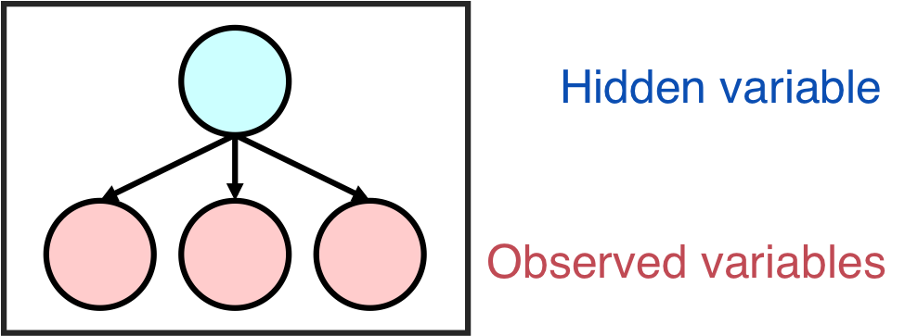
Learning Mixture Models
Structured distribution of the M-dimensional random vector:
Given N i.i.d. samples estimate the model parameters such that
N: sample complexity
Notes:
Latex:
H\in\{1,\dots, K\}
X = (X_1, X_2, \dots, X_M)\in\mc X
\Pr(X) = \sum_{k=1}^K\underbrace{\Pr(H=k)}_{\tx{mixing weights}}\cdot\underbrace{\Pr(X_1| H=k) \Pr(X_2| H=k) \Pr(X_3| H=k) }_{\tx{conditional probabilities}}
\Pr(X) = \sum_{k=1}^K\underbrace{\Pr(H=k)}_{\tx{mixing weights}\cdot \underbrace{\Pr(X| H=k)}_{\tx{conditional probabilities}}
X(1),X(2),\dots, X(N)
\ta= (\tx{mixing weight, conditional distributions})
\lt\|\wh \ta - \ta \rt\|\le \epsilon

Slide 4
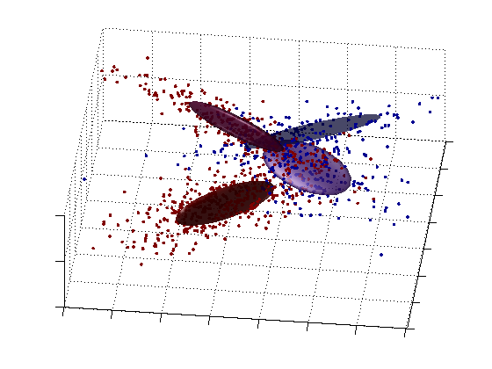
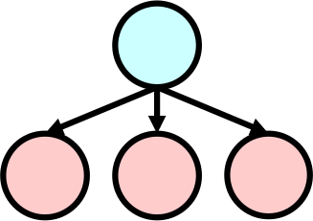

Learning Mixture Models
Gaussian Mixtures (GMMs)
Cluster
n-dim data points
Topic Models (Bag of Words)
Topic
n words in each document

Slide 5
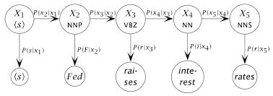
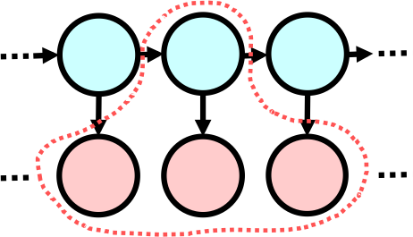
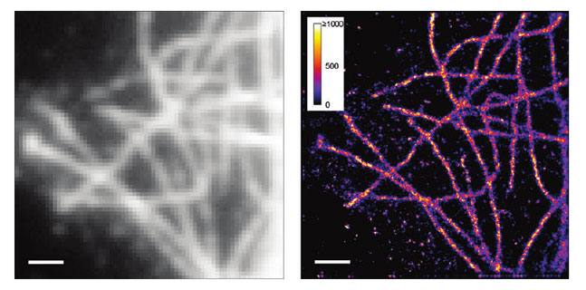
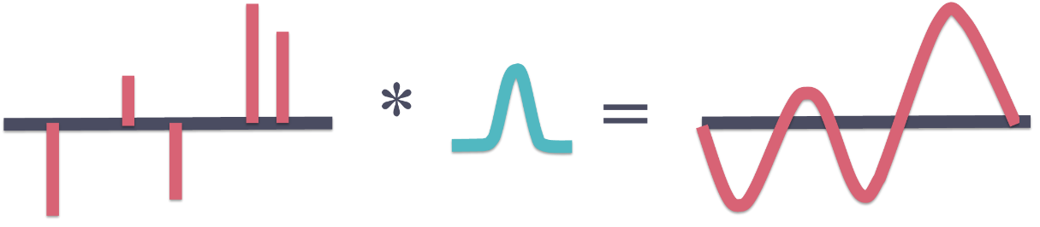
Learning Mixture Models
Hidden Markov Models (HMM)
Current state
Past, current, future
observations
Super-Resolution Microscopy
Source
Complex sinusoids
Notes:
Mention non-parametric but we are only considering these

Slide 6
Parameter Learning / Estimation
Given N i.i.d. samples of X, estimate model parameters to target accuracy
Maximum Likelihood Estimation (MLE)
Impossibility results on complexity (worst case exponential lower bounds )
MLE (is asymptotically statistical efficient) but non-convex optimization
Notes:
\wh\ta_{MLE} &= \arg\max\sum_{i=1}^N \log\lt(\Pr(X(i)| \ta)\rt)
\\&= \arg\max\sum_{i=1}^N \log\lt(\sum_{k=1}^K \Pr(H= k|\ta) \Pr(X(i)| H= k, \ta)\rt)
&= \arg\max_{\ta} \log\lt(\Pr(X(1),\dots, X(N))|\ta\rt)
\\

Slide 7
Challenges
Can we learn non-worst-cases with provable guarantees?
Yes! Polynomial algorithms for GMMs, HMMs, Super-resolution
Can we achieve optimal sample complexity in a tractable way?
Yes! Estimation of low rank probability matrices with linear sample complexity

Slide 8
Contributions / Outline
Can we learn non-worst-cases with provable guarantees?
Yes! Polynomial algorithms and analysis for GMMs, HMMs, Super-resolution
Can we achieve optimal sample complexity in a tractable way?
Yes! Estimation of low rank probability matrices with linear sample complexity
PART 1
PART 2

Slide 9
PART 1
Can we learn non-worst-cases with provable guarantees?
Polynomial Algorithms for Learning GMM, HMM and S-R
Propose provable algorithms to learn mixture models
Go beyond worst-case analysis with probabilistic arguments

Slide 10
Spectral Algorithms and Tensor Decomposition
Multi-way array in matlab
2-way tensor =matrix
3-way tensor:

Slide 11
Tensor Decomposition
Sum of rank one tensors
Tensor rank: minimum number of
summands in a rank decomposition
Notes:
CANDECOMP-PA RAFAC
Canonical decomposition Parallel Factor analusis

Slide 12
Tensor Decomposition
Necessary condition for unique tensor decomposition
Suppose admits rank-k decomposition . If and are of full rank k, and has rank we can decompose to uniquely find the factors in poly time and stability depends poly on condition number
Low rank tensor decomposition algorithm boils down to matrix SVD
This is the only thing about tensor we need for this talk perhaps also the only provable and practical thing about tensor decomposition
Notes:
M = A\ot B\ot C

Slide 13
Spectral Algorithms and Tensor Decomposition
random process
statistics
Mixture model -> conditional independence -> Low rank of M
Algorithm design (what statistics?) Algorithm analysis (algorithm stable?)
Notes:
\wh A\ot \wh B\ot \wh C =\wh M
\approx
\wh\ta

Slide 14
PART 1.1
Can we learn non-worst-cases with provable guarantees?
Polynomial Spectral Algorithms for Learning Gaussian Mixtures

Slide 15
1.1 Learn GMMs:
Setup
Cluster
M-dim data points
-dimensional -mixture
Parameters: weights means covariance matrices
Draw samples :
Can we learn the parameters with poly algorithm for every GMM ?
Notes:
x\in\R^{n}

Slide 16
1.1 Learn GMMs:
Hardness Result
Can we learn the parameters to accuracy ε in poly time using poly samples
for every GMM instance ?
No!
Exponential dependence in k is unavoidable in general. [Moitra&Valiant]
Can we learn the parameters with poly algorithm for most instances?
Yes! Worst cases are not everywhere

Slide 17
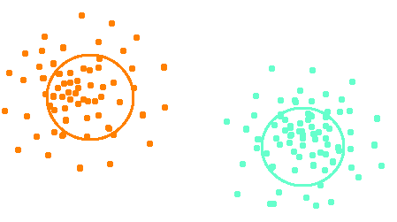
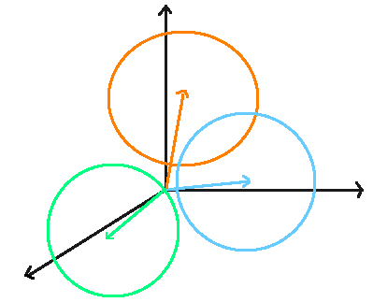
1.1 Learn GMMs:
Prior Works
General case
Moment matching method [Moitra&Valiant] [Belkin&Sinha]
With additional assumptions on
Non-overlapping clusters
Pair wise clustering [Dasgupta]…[Vempala&Wang]
Spherical, n>k, independent mean vectors
Lower order moments tensor decomposition [Hsu&Kakade]
Density estimation [Chan et al]
1-dim Higher dim
Notes:
Pace up

Slide 18
Main Theorem
1.1 Learn GMMs
Our algorithm learns the GMM parameters up to accuracy ε
For high enough dimension
With high probability under smoothed analysis
Fully polynomial time and sample complexity

Slide 19
Escape from the worst cases
1.1 Learn GMMs:
Smoothed Analysis Framework
Given an arbitrary instance
Nature perturbs the parameters with a small amount (ρ) of noise
Observe data generated by , design and analyze algorithm for
Bridge worst case and average case algo analysis
[Spielman&Teng]
Hope：With high probability over nature’s perturbation, an arbitrary instance
escapes from the degenerate cases, and becomes well conditioned
Our Goal: Given samples from smoothed GMM, learn the smoothed parameters with negligible failure probability over nature’s perturbation

Slide 20
Algorithmic Ideas
1.1 Learn GMMs:
Method of moments: (match 4-th and 6-th moments ) Decomposing moments tensor (tensor not low rank, but structured)
(n-dimensional k-mixture)
Why “high dimension” & “smoothed analysis” help us to learn?
Enough number of moment matching constraints for identifiability
#parameters #6-th moments
Enough randomness in nature perturbation for well-condition with high probability
Notes:
(n-dim, k-mixture)

Slide 21
Example: Learn mixture of 0-mean Gaussians
Algorithmic Ideas
1.1 Learn GMMs:
(clean moment structure)
Structured tensor
estimate from data
Structured linear projection
Desired
low rank tensor!
Recover low rank tensors from their linear projections
Exploit the structure of the linear projections particular to GMM
Notes:
&X_4= \sum_{i=1}^k \Sigma^{(i)}\ot\Sigma^{(i)},
\\
&X_6= \sum_{i=1}^k \Sigma^{(i)}\ot\Sigma^{(i)} \ot\Sigma^{(i)}.

Slide 22
PART 1.2
Can we learn non-worst-cases with provable guarantees?
Polynomial Spectral Algorithms for Learning Hidden Markov Models

Slide 23
Setup
1.2 Learn HMMs:
Hidden state
Observation
N = 2n+1 window size
Transition prob:
Observation prob:
Given sequences of observation, how to recover Q, O ？
How large the window size N needs to be?
Notes:
\ta = (Q, O)
Q\in\mbb R^{k\times k}\quad Q_{j,i}=\Pr(h_{t+1}=j\big|h_{t} = i)
O\in\mbb R^{d\times k}\quad O_{j,i}=\Pr(x_{t}=j\big|h_{t} = i)

Slide 24
1.2 Learn HMMs:
Hardness Results
Cannot learn in poly time, unless RP=NP
HMM is not efficiently PAC learnable, under noisy parity assumption
Construct an instance, reduction to parity of noise
If number of states = 4k - 1, then required window size N = k
Complexity is
[Abe,Warmuth] [Kearns]
Hidden state
Observation
N = 2n+1 window size
Notes:
\Omega(d^k)
[k]

Slide 25
1.2 Learn HMMs:
Main Result
Excluding a measure 0 set in the parameter space of for all most all HMM instances, the required window size is
Spectral alg achieves sample complexity and runtime both
Notes:
\Omega(d^k)
N = \Theta(\log_{d}k)
poly(d,k)

Slide 26
1.2 Learn HMMs:
Algorithmic idea
1. Estimate , “pretend” is , try low rank tensor decomp
Tensor decomposition condition: A, B rank = k, C rank ≥ 1
2. Extract from tensor factors A B
Notes:
M = \Pr\big((x_{n-1},\dots,x_{-1}), x_{0},(x_{1},\dots, x_{n}) \big) \ \in \R^{d^n\times d^n\times d}
&A = \Pr\big(x_1,x_2,\dots,x_{n}\big|h_0\big)
\\
&B = \Pr\big(x_{-1},x_{-2},\dots,x_{-n}\big|h_0\big)
\\
&C = \Pr\big(x_0, h_0\big)

Slide 27
1.2 Learn HMMs:
Key lemma
N = 2n+1 window size
Generic analysis
If , excluding a measure 0 set in parameter space of we have A and B of full rank k, and rank C >1.
Worst cases all in a measure 0 set！

Slide 28
PART 1.3
Can we learn non-worst-cases with provable guarantees?
Polynomial Spectral Algorithms for Super-Resolution

Slide 29
Setup
1.3 Super-Resolution:
Band-limited Fourier measurements
*
=
Source
Complex sinusoids
How to recover the point sources with coarse measurement of the signal?
small number of measurements
Low cutoff frequency
Notes:
Analogy of sample comlexity (how well the data reflect the underlying truth )
ban

Slide 30
Problem Formulation
1.3 Super-Resolution:
Recover point sources (d-dimensional k-mixture)
using bandlimited and noise corrupted measurements.
Achieve target accuracy
*
(Fourier measurements)
(Measurement noise)
Notes:
Analogy of sample comlexity (how well the data reflect the underlying truth )
\|\wh\mu^{(j)} - \mu^{(j)} \|_2\le \epsilon, \fa j\in[k]
\|s\|_{\infty}\le \tx{cutoff freq}
\wt f(s) = \sum_{j=1}^{k}w_j e^{i\pi<\mu^{(j)},s>} + z(s)

Slide 31
Prior Works
1.3 Super-Resolution:
Minimum separation
1-dim
Take uniform measurements on the grid
Cut-off frequency
Hardness result
Compressed sensing off the grid use random measurements to recover measurements
Mult-dim
Mult-dim grid
Algo complexity
[Candes, Fernandez-Granda]
[Moitra]
[Tang, Bhaskar, Shah, Recht]
Notes:
s\in\{-N,\dots, -1, 0, 1, \dots, N\}^{\textcolor{red}{d}}
N > {C\over \Delta}
O\lt(poly(k, \textcolor{red}{1\over \Delta})\rt)^{\textcolor{red}{d}}

Slide 32
Main Theorem
1.3 Super-Resolution:
Our algorithm achieves stable recovery
with number of measurements and runtime
cutoff freq of the measurements bounded by
with runtime
For a small error probability
Notes:
O((k + d)^2)
O((k+d)^3)
O(1/\Delta)
\begin{table}
% \centering
\renewcommand{\arraystretch}{1.7}
\hspace*{-0.25in}
\begin{tabular}[]{|c|c|c|c|}
\hline
& cutoff freq & measurements & runtime
\\
\hline
SDP
& ${C_d\over \Delta_{\infty}}$ & $({1\over \Delta_{\infty}})^d$ & $poly(({1\over \Delta_{\infty}})^d,k)$
\\
\hline
MP
& - & - & -
\\
\hline
\textcolor{red}{Ours}
& ${\log(kd)}\over \Delta$ & {$(k\log(k)+d)^2$} & {$(k\log(k)+d)^2$}
\\
\hline
\end{tabular}
\end{table}

Slide 33
Algorithmic Idea
1.3 Super-Resolution:
Tensor decomposition with measurements on random frequencies d
Random samples such that admits particular low rank decomp
(Rank-k 3-way tensor)
(Vandermonde Matrix
with complex nodes)
Skip intermediate step of recovering all the measurements on the hyper-grid
Prony’s method (Matrix-Pencil / MUSIC / ESPRIT) as a special case of choosing
Notes:
d\times d\times k

Slide 34
Algorithmic Idea
1.3 Super-Resolution:
Tensor decomposition with measurements on random frequencies
Why we do not contradict the hardness result?
If we design a fixed grid of to take measurements there always exists model instances such that the particular grid fails
Let the locations of be random (with structure for tensor decomp) then for any model instance, algo works with high probability
vs
Notes:
f(s)

Slide 35
Take-away from PART 1
Provable algorithms to learn mixture models
Different algorithm for each problem
Underlying sparsity → Conditional independence → Low rank
Go beyond worst-case analysis
Randomness in the model parameters (to escape worst case)
Smoothed analysis for GMM
Generic analysis for HMM
Randomness in the algorithm (with a large chance to succeed)
Random sampling off the grid for S-R

Slide 36
Spectral methods for Learning Mixture Models
Pros:
Fast runtime (spectral decomposition of low rank matrix/tensor)
Polynomial sample complexity (when escaping non-worst-cases)
Cons:
High sample complexity (when compared to MLE)
Sensitive to model misspecification (rely on structural properties)
Efficiency
Robustness

Slide 37
PART 2
Can we achieve optimal sample complexity in a tractable way?
Estimate low rank probability matrices with linear sample complexity
At the core of many spectral methods
Our algorithm achieves statistical efficiency

Slide 38
2. Low rank matrix
Setup
Probability Matrix
i.i.d. samples from the distr
(distribution over outcomes)
( freq counts over outcomes)
is of rank 2:
.18 | .14 | .08 | .07 | .07
.14 | .29 | .09 | .07 | .10
.08 | .09 | .05 | .40 | .04
.08 | .07 | .04 | .04 | .04
.07 | .10 | .04 | .05 | .05
.40
.20
.15
.15
.10
.15
.40
.15
.10
.20
5 | 3 | 2 | 1 | 1
3 | 4 | 1 | 0 | 1
2 | 2 | 1 | 0 | 1
2 | 1 | 0 | 1 | 0
1 | 2 | 1 | 0 | 0
Goal: find rank-2 such that
N sample complexity: upper bound algorithm, lower bound
Notes:
Probability Matrix \mbb B\in\R_+^{M\times M}
(distribution over M^2 outcomes)
N i.i.d. samples from
Sample counts over M^2 outcomes B
B is of rank 2
\mbb B = pp^\top + qq^\top,
B =\tx{Poisson}( N\mbb B)
M = 5
N = 20

Slide 39
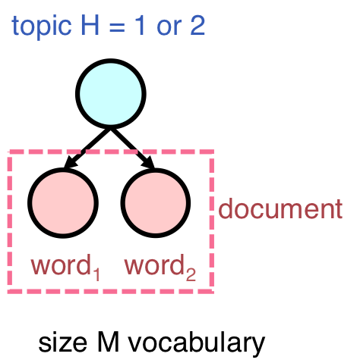
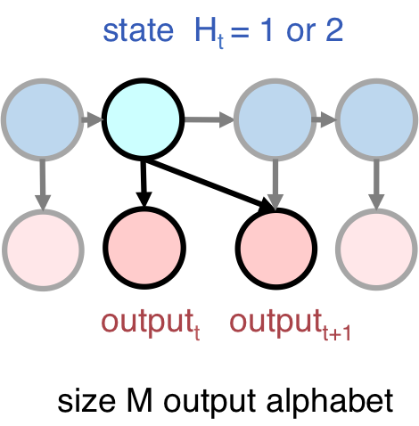
2. Low rank matrix
Connection to mixture models
Topic
model
joint distribution over word pairs
HMM
distribution of consecutive outputs
empirical counts find low rank close to
N data samples
Extract parameters estimates
Notes:
, mention SBM also fits here
&\Pr(\tx{word}_1, \tx{word}_2 \big| \tx{topic}=T_1) = pp^\top
\\
&\Pr(\tx{word}_1, \tx{word}_2 \big| \tx{topic}=T_2) = qq^\top
&\Pr(\tx{output}_1, \tx{output}_2 \big| \tx{state}=S_i) = O_i (OQ_i)^\top

Slide 40
2. Low rank matrix
Attempt
generate
Probability Matrix
i.i.d. samples from the distr
(distribution over outcomes)
( freq counts over outcomes)
is of rank 2:
1st SVD
estimate
2nd SVD
?
Notes:
\rho: \sum \rho_i = 1
\Delta: \sum \Delta_i = 0
\wh \rho_i = \sum_j {1\over N} B_{i,j}

Slide 41
2. Low rank matrix
Sub-Optimal Attempt
Set to be the rank 2 truncated SVD of
To achieve estimation accuracy need
Not sample efficient!
MLE:
Small data in practice!
Word distribution in language has fat tail. More sample documents , larger the vocabulary size
Notes:
{1\over N}B ={1\over N}\tx{Poisson}( N\mbb B) \to \mbb B, \tx{ as } {N\to\infty}
\wh B
N = \Omega(M^2\log M)

Slide 42
Main Theorem
2. Low rank matrix
Matching upper and lower bound of linear sample complexity
Our upper bound algorithm:
Rank-2 estimate with accuracy
Using number of sample counts
Runtime
We prove (strong) lower bound:
Need a sequence of observations to test whether the sequence is i.i.d. of unif (M) or generated by a 2-state HMM
Notes:
\wh B
\|\wh B - \mbb B \|_1\le \epsilon,
N = \O(M/\epsilon^2)
O(M^3)
\Omega(M)

Slide 43
2. Low rank matrix
Algorithmic Idea
Capitalize the idea of community detection in sparse random network
Expected connection
nodes 2 communities
Adjacency matrix
.09 | .09 | .09 | .02 | .02 | .02
.09 | .09 | .09 | .02 | .02 | .02
.09 | .09 | .09 | .02 | .02 | .02
.02 | .02 | .02 | .09 | .09 | .09
.02 | .02 | .02 | .09 | .09 | .09
.02 | .02 | .02 | .09 | .09 | .09
.30
.30
.30
.03
.03
.03
.03
.03
.03
.30
.30
.30
1 | 1 | 0 | 0 | 1 | 0
1 | 1 | 1 | 0 | 1 | 1
0 | 1 | 1 | 0 | 1 | 0
0 | 0 | 0 | 0 | 1 | 1
1 | 1 | 1 | 1 | 1 | 1
0 | 1 | 0 | 0 | 1 | 1
generate
estimate
Notes:
M nodes
B = \tx{Bernoulli}(N\mbb B)
N =

Slide 44
2. Low rank matrix
Algorithmic Idea
Capitalize the idea of community detection in sparse random network
Expected connection
nodes 2 communities
Adjacency matrix
Regularize Truncated SVD:
remove heavy row/column from B (hubs) rank-2 SVD on remaining graph
[Le, Levina, Vershynin]
.09 | .09 | .09 | .02 | .02 | .02
.09 | .09 | .09 | .02 | .02 | .02
.09 | .09 | .09 | .02 | .02 | .02
.02 | .02 | .02 | .09 | .09 | .09
.02 | .02 | .02 | .09 | .09 | .09
.02 | .02 | .02 | .09 | .09 | .09
.30
.30
.30
.03
.03
.03
.03
.03
.03
.30
.30
.30
1 | 1 | 0 | 0 | 1 | 0
1 | 1 | 1 | 0 | 1 | 1
0 | 1 | 1 | 0 | 1 | 0
0 | 0 | 0 | 0 | 1 | 1
1 | 1 | 1 | 1 | 1 | 1
0 | 1 | 0 | 0 | 1 | 1
generate
estimate
Notes:
M nodes
B = \tx{Bernoulli}(N\mbb B)
N =

Slide 45
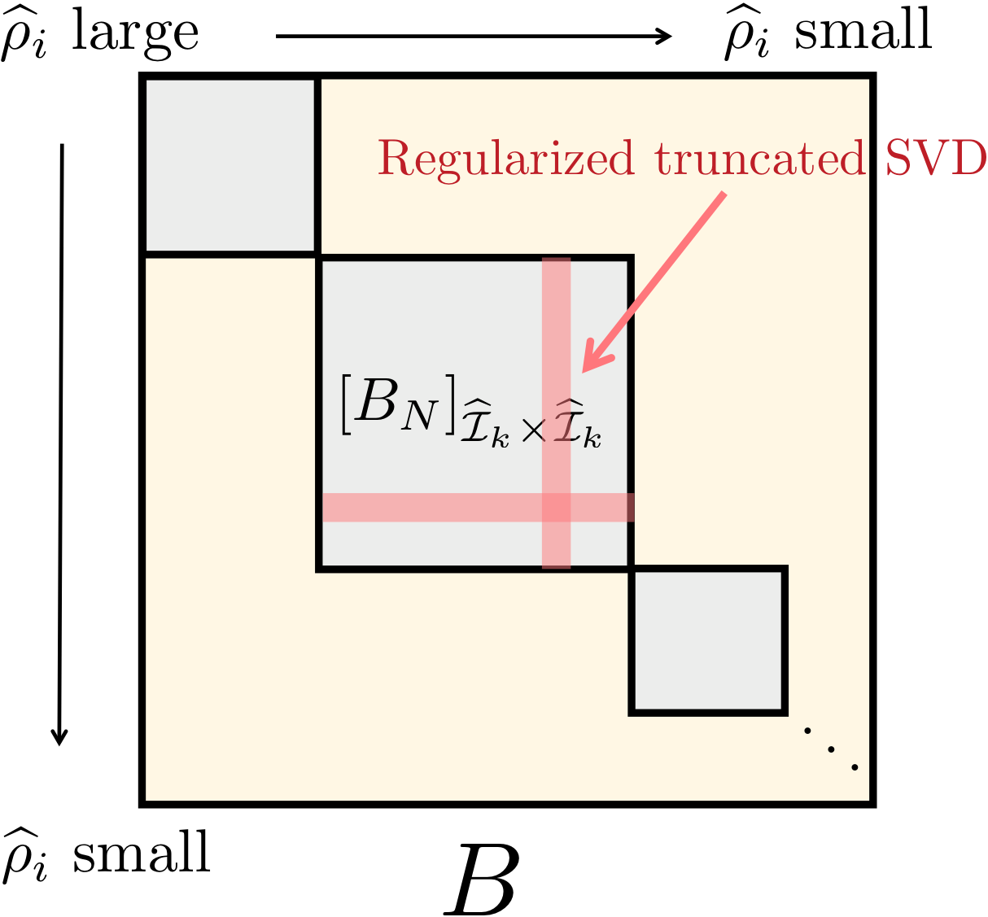
2. Low rank matrix
Algorithmic Idea 1, Binning
Probability matrix
Sample counts
Phase 1
Estimate non-uniform marginal
Bin M words according to
Regularized t-SVD in each bin × bin block of to estimate
Need to deal with spillover!
Piece together estimates over bins!
Notes:
\wh\rho_i
\wh\rho_{\mc I}, \wh\Delta_{\mc I}
\mbb B = \rho\rho^\top + \Delta\Delta^\top
B = {1\over N}Poi( N\mbb B)

Slide 46
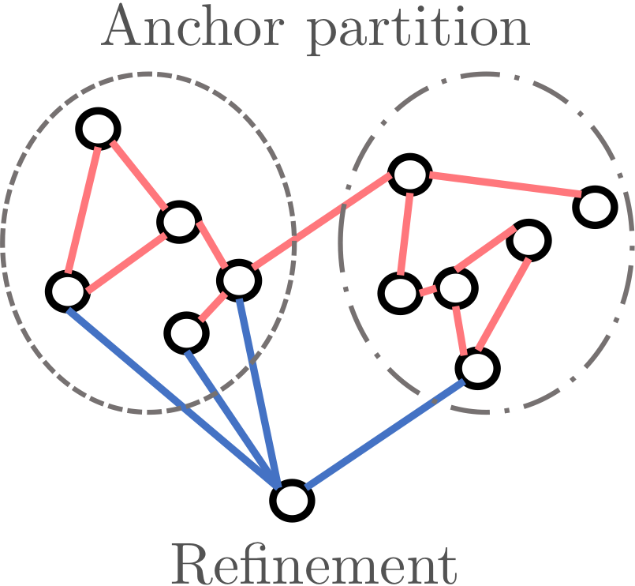
2. Low rank matrix
Algorithmic Idea 2, Refinement
Probability matrix
Sample counts
Phase 2
Get rough estimate for many words from Phase 1
Make this global info to refine the estimate for each word (just linear regression)
Achieve sample complexity
Notes:
\wh\rho, \wh\Delta
\wh\rho_i, \wh\Delta_i

Slide 47
Take-away from PART 2
Spectral method is not solving the optimization of MLE
Need careful algorithm design to improve statistical efficiency
We identify a problem that lies at the core of many spectral algos
Our result (upper / lower bound) leads to improved algos
Coming soon: estimation / approximation / property testing of structured probability distribution

Slide 48
Conclusion and Future works
Spectral methods for Learning Mixture Models
Pros: Fast runtime
Poly sample complexity
Cons: High sample complexity Efficiency
Sensitive to model misspecification Robustness
Future work:
Dynamics: Extend the analysis techniques and algorithmic ideas to learning of random processes, with streaming data, iterative algorithms…
Robustness: Agnostic learning, generalization error analysis…
PART 1
PART 2

Slide 49
References
“Learning Mixture of Gaussians in High dimensions” Rong Ge, H, Sham Kakade (STOC 2015)
“Super-Resolution off the Grid” H, Sham Kakade (NIPS 2015)
“Minimal Realization Problems for Hidden Markov Models” H, Rong Ge, Sham Kakade, and Munther Dahleh (IEEE Transactions on Signal Processing, 2016)
“Recovering Structured Probability Matrices “ H, Sham Kakade, Wenhao Kong, Gregory Valiant, (submitted to STOC 2016)

Slide 50
References
“Learning Mixture of Gaussians in High dimensions” Rong Ge, H, Sham Kakade (STOC 2015)
“Super-Resolution off the Grid” H, Sham Kakade (NIPS 2015)
“Minimal Realization Problems for Hidden Markov Models” H, Rong Ge, Sham Kakade, and Munther Dahleh (IEEE Transactions on Signal Processing, 2016)
“Recovering Structured Probability Matrices “ H, Sham Kakade, Wenhao Kong, Gregory Valiant, (submitted to STOC 2016)
Thank you !
Question?

